Slide 1
Advanced Programming
Standard Template Library
Containers, Operators, Iterators
Adriana Paluszny
[Many of the slides are adapted from the original Bjarne Stroustrup slides on C++]

Slide 2
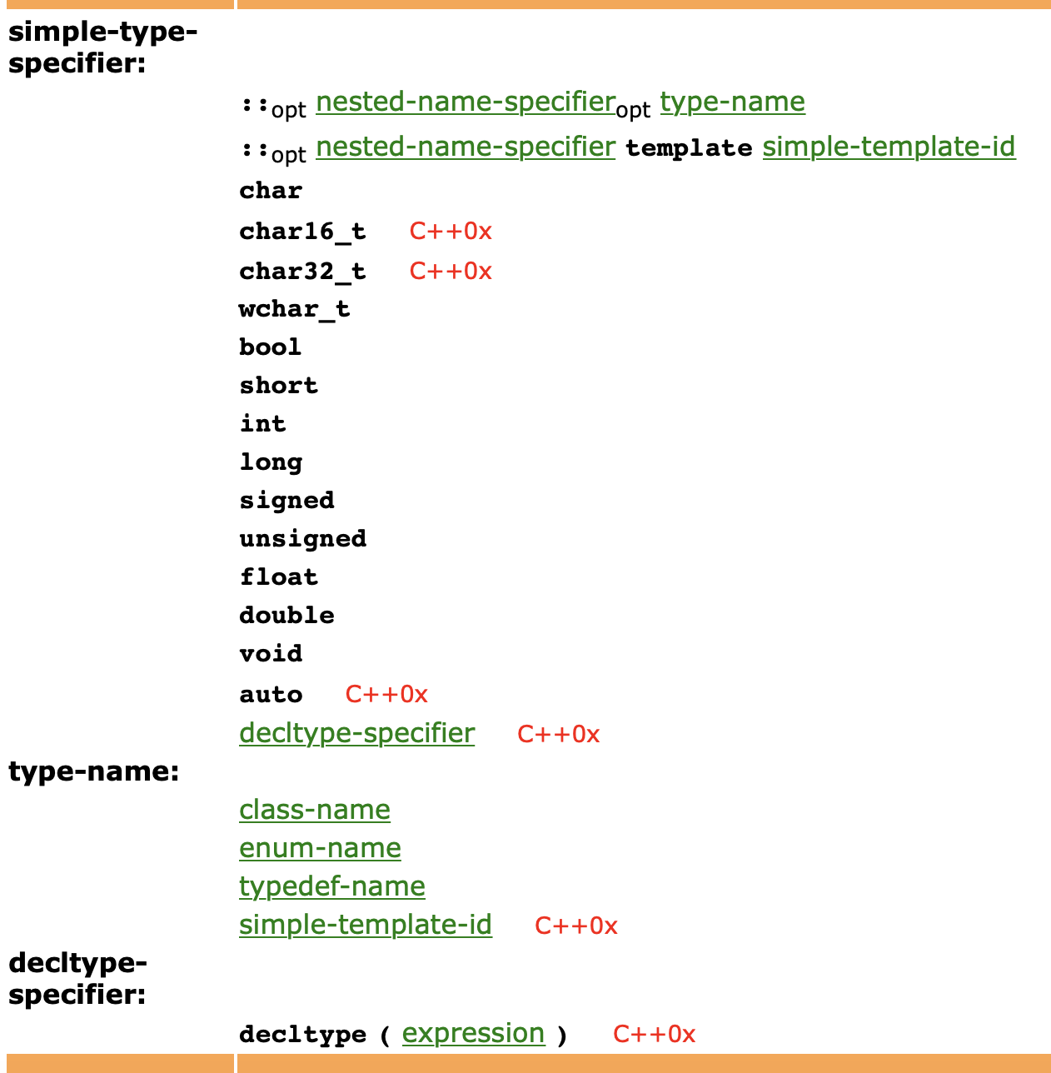
Objects
Advanced Programming
from the c++ grammar
These are ways of creating new types beyond the native types
Create objects:
class
enum
typedef
And… templates
These are “typename”s.
http://www.nongnu.org/hcb/

Slide 3
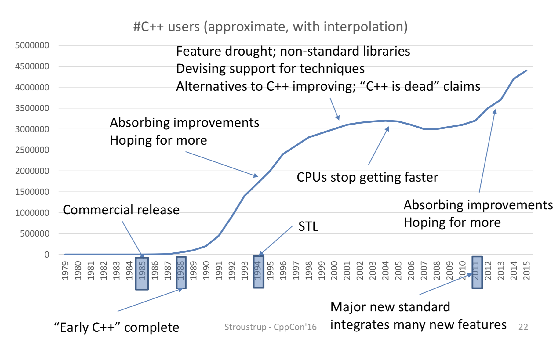
“C++ Success” by Bjarne Stroustrup
Advanced Programming

Slide 4
Common tasks
Collect data into containers
Organize data
For printing
For fast access
Retrieve data items
By index (e.g., get the Nth element)
By value (e.g., get the first element with the value "Chocolate")
By properties (e.g., get the first elements where “age<64”)
Add data
Remove data
Sorting and searching
Simple numeric operations

Slide 5
Aims
We aim to write code that is
Easy to read
Easy to modify
Regular
Short
Fast
Uniform access to data
Independently of how it is stored
Independently of its type
Type-safe access to data
Easy traversal of data
Compact storage of data
Fast
Retrieval of data
Addition of data
Deletion of data
Standard versions of the most common algorithms
Copy, find, search, sort, sum, …

Slide 6
Generic programming
Generalize algorithms
Sometimes called “lifting an algorithm”
The aim (for the end user) is
Increased correctness
Through better specification
Greater range of uses
Possibilities for re-use
Better performance
Through wider use of tuned libraries
Unnecessarily slow code will eventually be thrown away
Go from the concrete to the more abstract
The other way most often leads to bloat

Slide 7
The STL
Part of the ISO C++ Standard Library
Mostly non-numerical
Only 4 standard algorithms specifically do computation
Accumulate, inner_product, partial_sum, adjacent_difference
Handles textual data as well as numeric data
E.g. string
Deals with organization of code and data
Built-in types, user-defined types, and data structures
Optimizing disk access was among its original uses
Performance was always a key concern

Slide 8
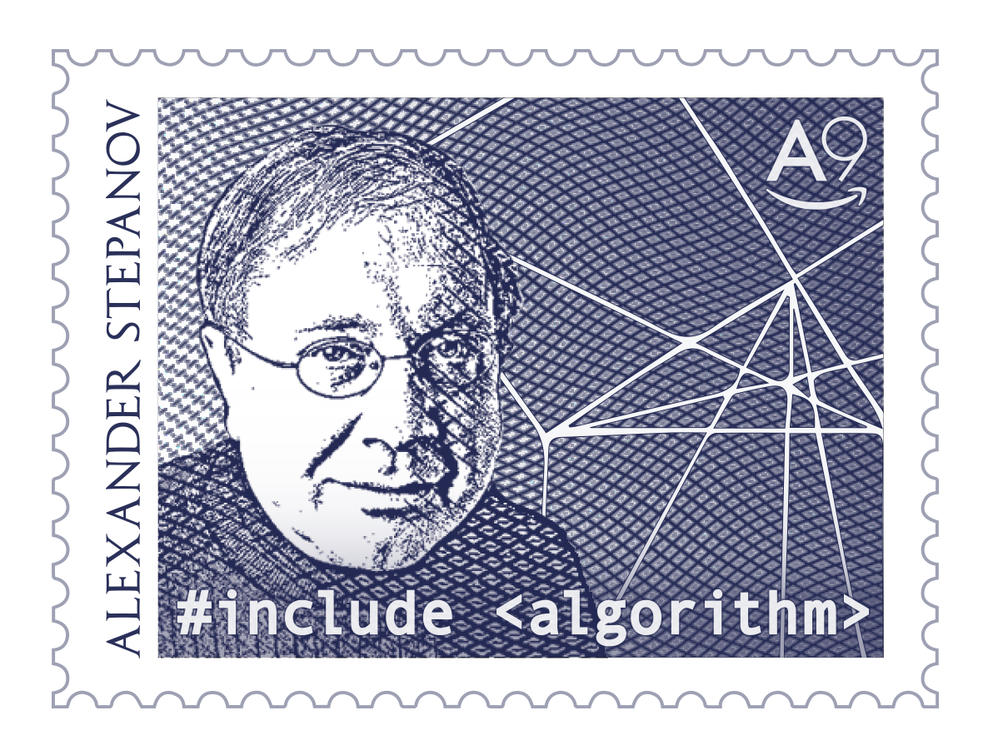
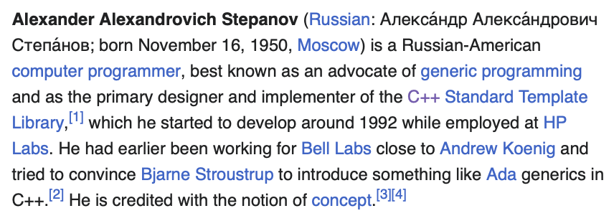
The STL
Designed by Alex Stepanov
General aim: The most general, most efficient, most flexible representation of concepts (ideas, algorithms)
Represent separate concepts separately in code
Combine concepts freely wherever meaningful
General aim to make programming “like math”
or even “Good programming is math”
works for integers, for floating-point numbers, for polynomials, for …

Slide 9
The Standard Template Library, or STL
Advanced Programming
STL is a C++ library of container classes, algorithms, and iterators;
it provides many of the basic algorithms and data structures of computer science.
The STL is a generic library, meaning that its components are heavily parameterized: almost every component in the STL is a template.
You should make sure that you understand how templates work in C++ before you use the STL.
-SGI Introduction to the Standard Template Library

Slide 10
STL Library
Advanced Programming
Code reuse, abstraction and optimization of containers and algorithms
Efficient (fast and less resources)
Accurate (less bugs)
Readable code
Standardised
A good example of what a library should be

Slide 11
Types of Containers
Advanced Programming
Sequence containers (arrays and linked lists)
Vector, deque, list, forward list
Associative containers (binary tree)
Set, multiset
Map, multimap
Unordered containers (hash table)
Unordered set/multiset
Unordered map/multimap

Slide 12
Basic model
Separation of concerns
Algorithms manipulate data, but don’t know about containers
Containers store data, but don’t know about algorithms
Algorithms and containers interact through iterators
Each container has its own iterator types
Algorithms
sort, find, search, copy, …
iterators
Containers
vector, list, map, unordered_map, …

Slide 13
The STL
An ISO C++ standard framework of about 10 containers and about 60 algorithms connected by iterators
Other organizations provide more containers and algorithms in the style of the STL
Boost.org, Microsoft, …
Probably the currently best known and most widely used example of generic programming

Slide 14
Basic model
A pair of iterators defines a sequence
The beginning (points to the first element – if any)
The end (points to the one-beyond-the-last element)
begin:
end:
…
An iterator is a type that supports the “iterator operations”
++ Go to next element
* Get value
== Does this iterator point to the same element as that iterator?
Some iterators support more operations (e.g. --, +, and [ ])

Slide 15
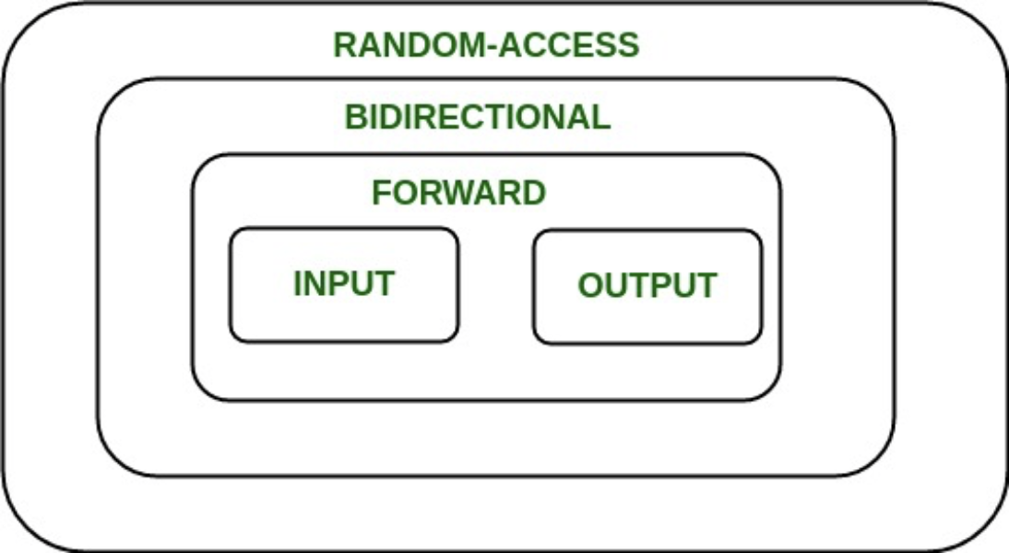
Iterators
“An iterator is an object that can iterate over elements in a C++ Standard Library container and provide access to individual elements. The C++ Standard Library containers all provide iterators so that algorithms can access their elements in a standard way without having to be concerned with the type of container the elements are stored in.”
https://docs.microsoft.com/en-us/cpp/standard-library/iterators?view=msvc-170

Slide 16
How iterators work
An iterator points to (refers to, denotes) an element of a sequence
The end of the sequence is “one past the last element”
not “the last element”
That’s necessary to elegantly represent an empty sequence
One-past-the-last-element isn’t an element
You can compare an iterator pointing to it
You can’t dereference it (read its value)
Returning the end of the sequence is the standard idiom for “not found” or “unsuccessful”
An empty sequence:
begin: end:
some iterator:
the end:
0
1
2
3

Slide 17
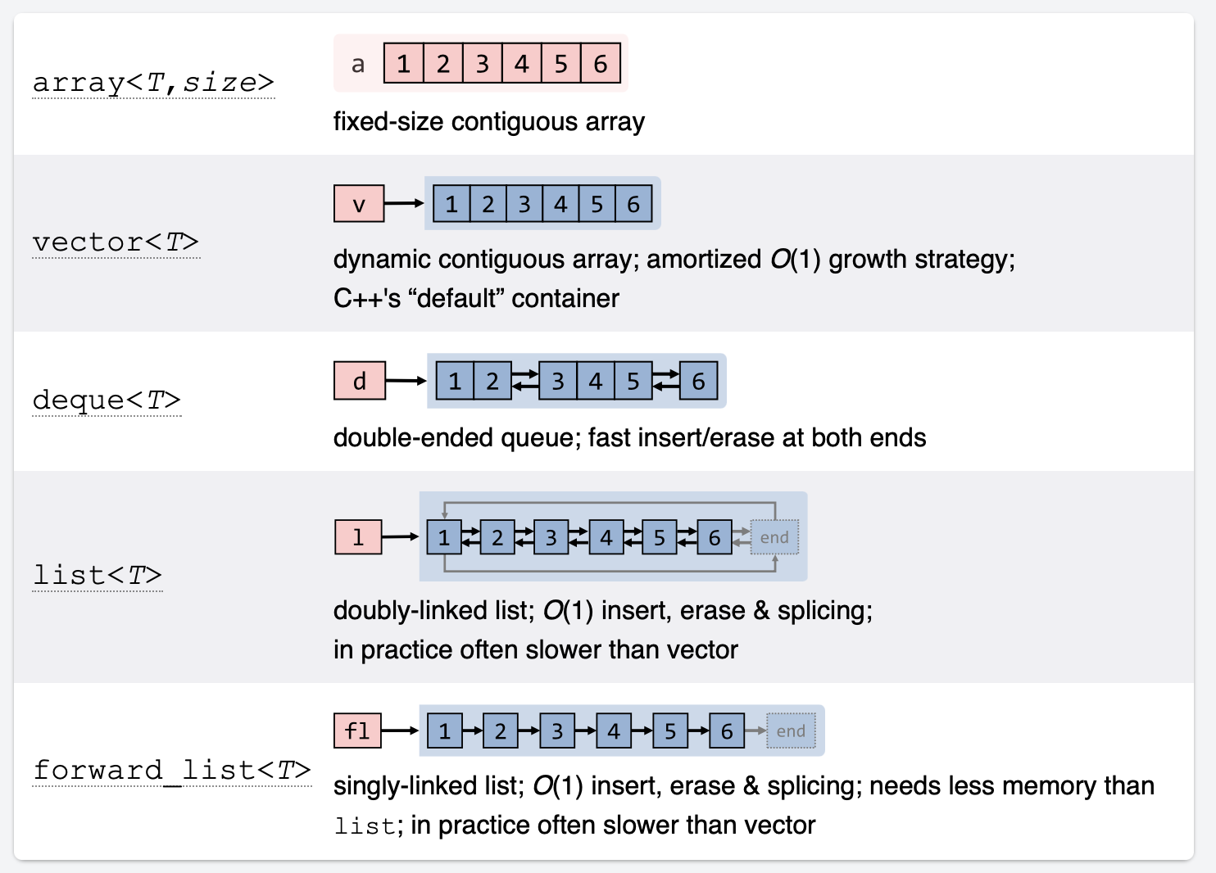
Sequence Containers
(hold sequences in difference ways)
Checkout this resource: https://hackingcpp.com/cpp/std/containers.html

Slide 18
vector
template<class T> class vector {
T* elements;
// …
using value_type = T;
using iterator = ???; // the type of an iterator is implementation defined
// and it (usefully) varies (e.g. range checked iterators)
// a vector iterator could be a pointer to an element
using const_iterator = ???;
iterator begin(); // points to first element
const_iterator begin() const;
iterator end(); // points to one beyond the last element
const_iterator end() const;
iterator erase(iterator p); // remove element pointed to by p
iterator insert(iterator p, const T& v); // insert a new element v before p
};

Slide 19
insert() into vector
vector<int>::iterator p = v.begin(); ++p; ++p; ++p;
vector<int>::iterator q = p; ++q;
q:
v:
6
p:
0
1
2
3
4
5
p=v.insert(p,99); // leaves p pointing at the inserted element
p:
q:
v:
7
0
1
2
99
3
4
5
Note: q is invalid after the insert()
Note: Some elements moved; all elements could have moved

Slide 20
erase() from vector
p:
q:
v:
7
0
1
2
99
3
4
5
p = v.erase(p); // leaves p pointing at the element after the erased one
p:
q:
v:
6
0
1
2
3
4
5
vector elements move when you insert() or erase()
Iterators into a vector are invalidated by insert() and erase()

Slide 21
list
Link:
T value
Link* pre
Link* post
template<class T> class list {
Link* elements;
// …
using value_type = T;
using iterator = ???; // the type of an iterator is implementation defined
// and it (usefully) varies (e.g. range checked iterators)
// a list iterator could be a pointer to a link node
using const_iterator = ???;
iterator begin(); // points to first element
const_iterator begin() const;
iterator end(); // points one beyond the last element
const_iterator end() const;
iterator erase(iterator p); // remove element pointed to by p
iterator insert(iterator p, const T& v); // insert a new element v before p
};

Slide 22
What happens when you insert() into a list?
list<int>::iterator p = v.begin(); ++p; ++p; ++p;
list<int>::iterator q = p; ++q;
v:
6
p:
q:
0
1
2
3
4
5
v = v.insert(p,99); // leaves p pointing at the inserted element
p:
q:
v:
7
0
1
2
3
4
5
Note: q is unaffected
Note: No elements moved around
99

Slide 23
What happens when you erase() from a list?
p:
q:
v:
7
0
1
2
3
4
5
99
p = v.erase(p); // leaves p pointing at the element after the erased one
p:
q:
v:
6
0
1
2
3
4
5
Note: list elements do not move when you insert() or erase()

Slide 24
Methods to traverse a vector
for(int i = 0; i<v.size(); ++i) // why int?
… // do something with v[i]
for(vector<T>::size_type i = 0; i<v.size(); ++i) // longer but always correct
… // do something with v[i]
for(vector<T>::iterator p = v.begin(); p!=v.end(); ++p)
… // do something with *p
Know both ways (iterator and subscript)
The subscript style is used in essentially every language
The iterator style is used in C (pointers only) and C++
The iterator style is used for standard library algorithms
The subscript style doesn’t work for lists (in C++ and in most languages)
Use either way for vectors
There are no fundamental advantages of one style over the other
But the iterator style works for all sequences
Prefer size_type over plain int
pedantic, but quiets compiler and prevents rare errors

Slide 25
Methods to traverse a vector
for(vector<T>::iterator p = v.begin(); p!=v.end(); ++p)
… // do something with *p
for(vector<T>::value_type x : v)
… // do something with x
for(auto& x : v)
… // do something with x
“Range for”
Use for the simplest loops
Every element from begin() to end()
Over one sequence
When you don’t need to look at more than one element at a time
When you don’t need to know the position of an element

Slide 26
vector vs. list
By default, use a vector
You need a reason not to
You can “grow” a vector (e.g., using push_back())
You can insert() and erase() in a vector
Vector elements are compactly stored and contiguous
For small vectors of small elements all operations are fast
compared to lists
If you don’t want elements to move, use a list
You can “grow” a list (e.g., using push_back() and push_front())
You can insert() and erase() in a list
List elements are separately allocated
Note that there are more containers, e.g.,
map
unordered_map

Slide 27
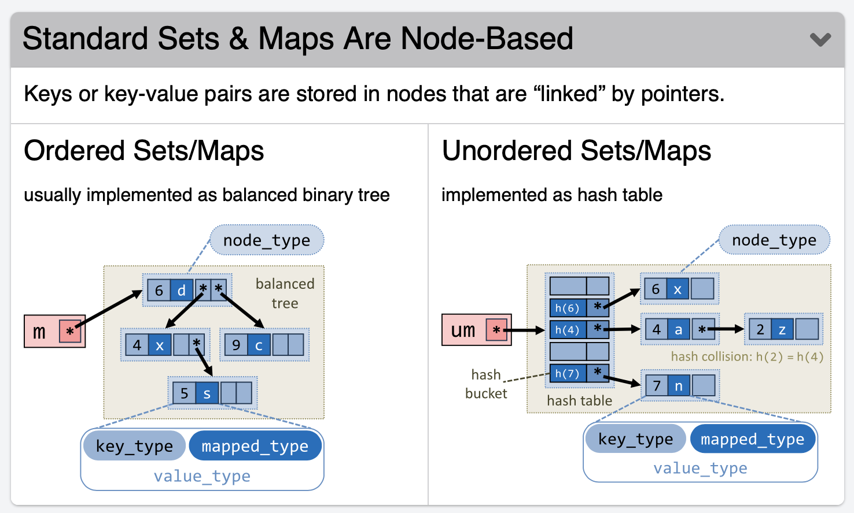
Associative Containers
https://hackingcpp.com/cpp/std/containers.html

Slide 28
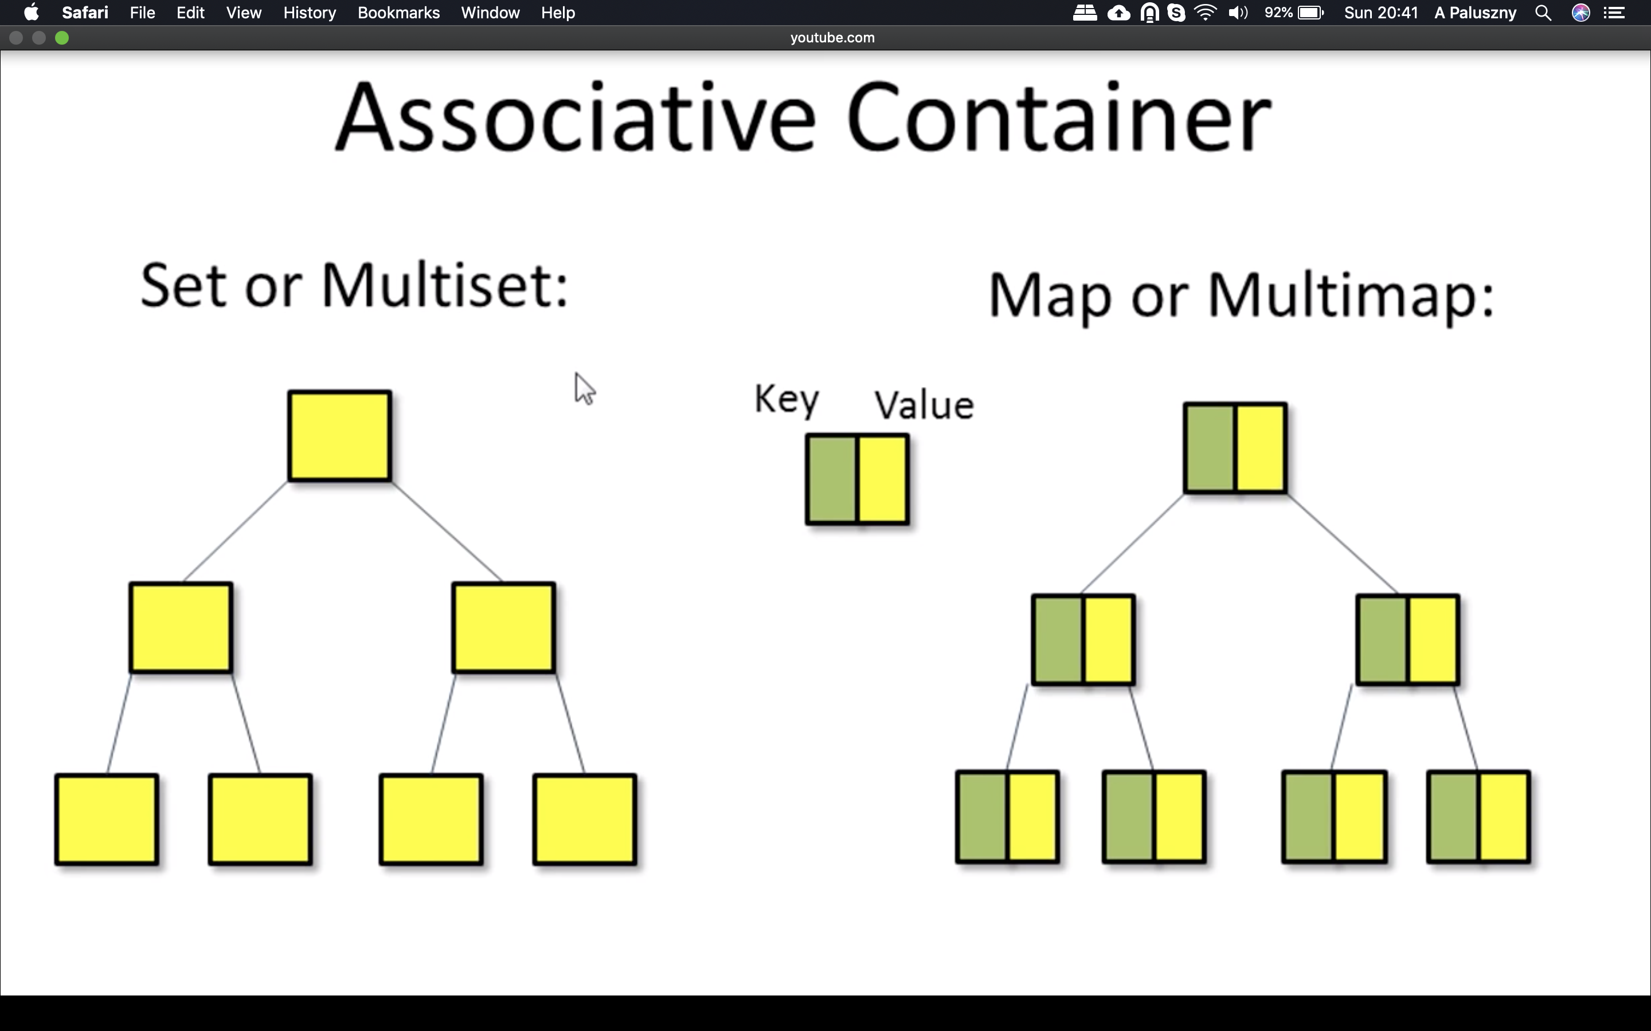
Associative Containers
Advanced Programming
stored as binary trees
The underlying data structure of an ordered associate container is a balanced search tree:
logarithmic access time
requires order comparisons of keys
iteration in key order
Iterators, pointers and references stay valid until the pointed to element is removed.
Image taken from Bo Qian’s YouTube “Introduction of STL 3: Associative Containers”

Slide 29
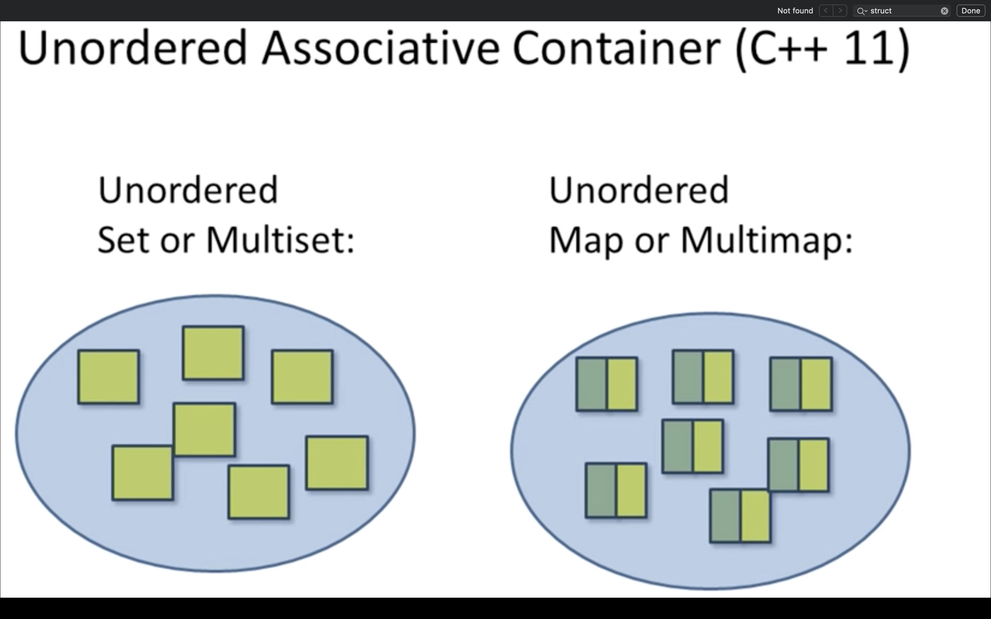
Unordered Containers
Advanced Programming
Stored using hash tables:
search, insert and delete in constant time
Image taken from Bo Qian’s YouTube “Introduction of STL 4: Unordered Containers”

Slide 30
std::set
A set is really an ordered balanced binary tree
By default ordered by <
For example, set<string> fruits;
set node:
Key first
Node* left
Node* right
…
fruits:
Orange
Grape
Quince
Apple
Kiwi
Plum

Slide 31
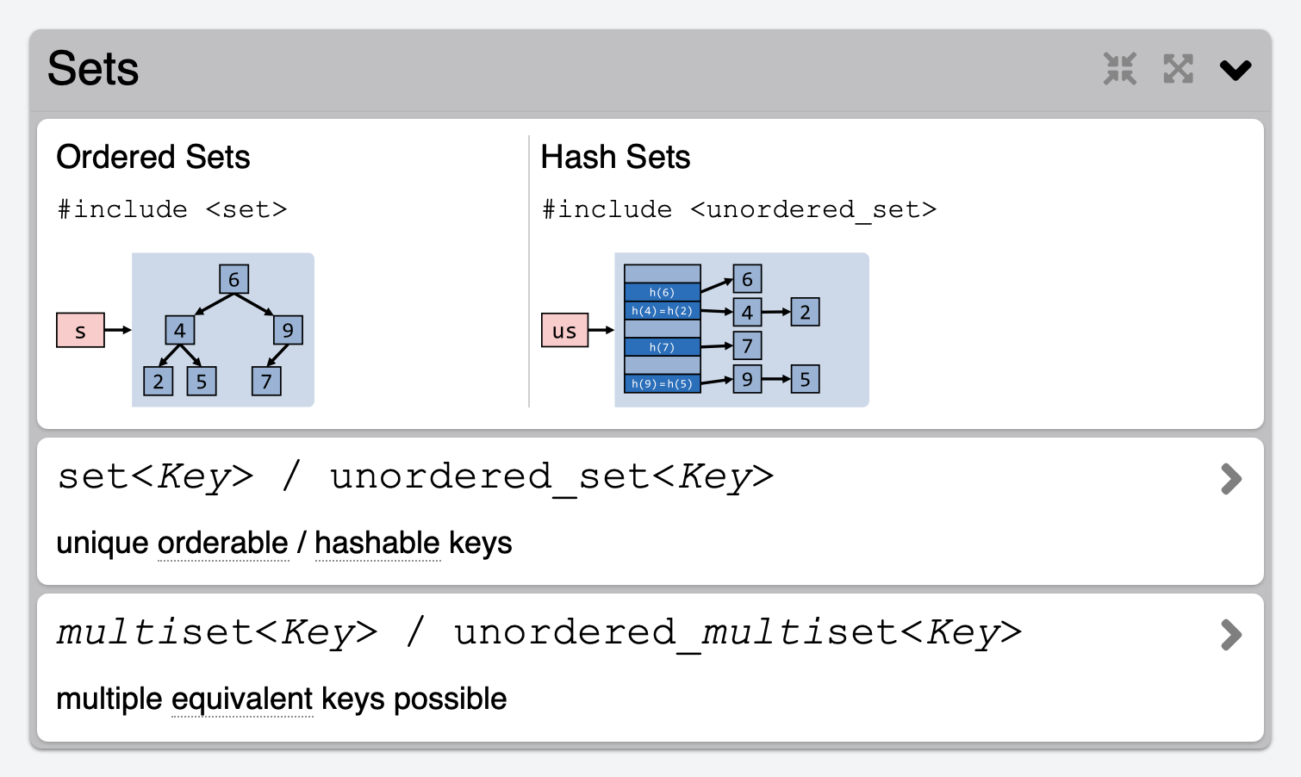
Associative Containers: Sets
https://hackingcpp.com/cpp/std/containers.html

Slide 32
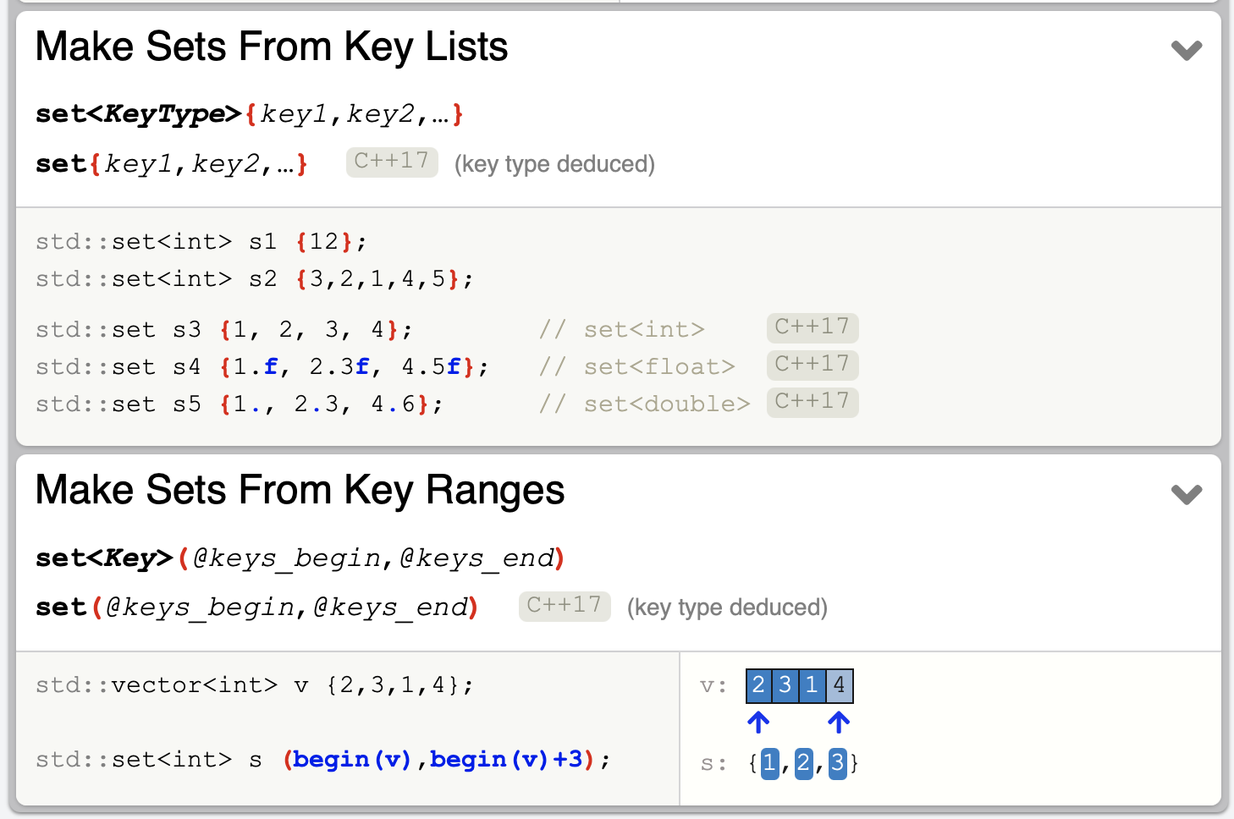
Example: Sets
https://hackingcpp.com/cpp/std/containers.html

Slide 33
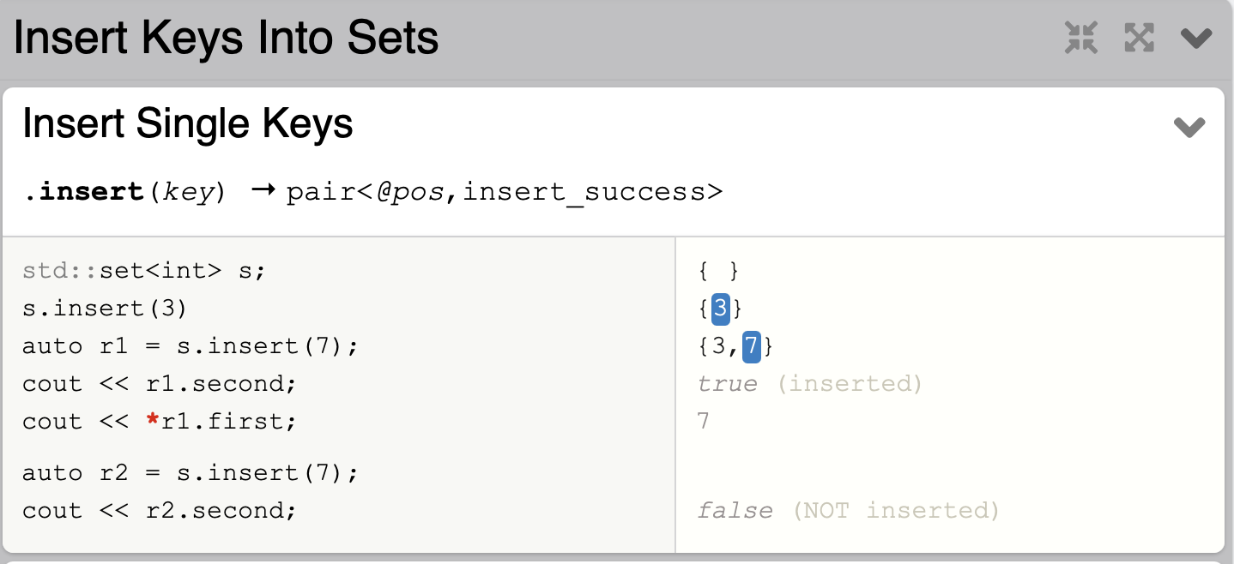
Insert elements: Set
https://hackingcpp.com/cpp/std/associative_containers.html#map

Slide 34
Map
After vector, map is the most useful standard library container
Maps (and/or hash tables) are the backbone of scripting languages
A map is really an ordered balanced binary tree
By default ordered by < (less than)
For example, map<string,int> fruits;
Map node:
Key first
Value second
Node* left
Node* right
…
fruits:
Orange 99
Grape 100
Quince 0
Apple 7
Kiwi 2345
Plum 8

Slide 35
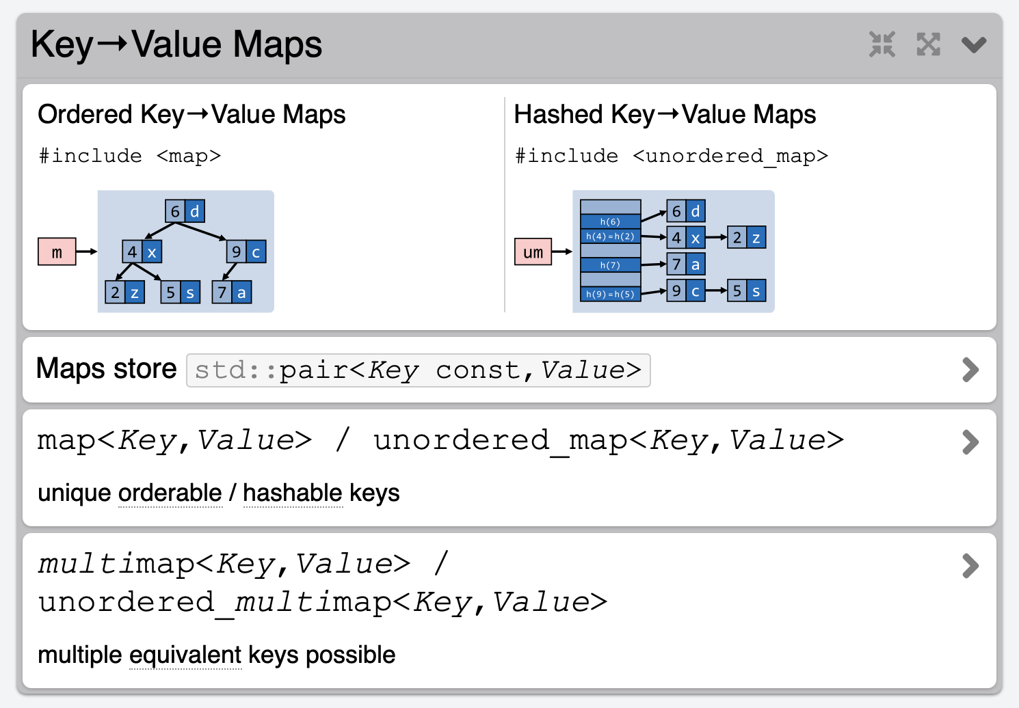
Associative Containers: Maps
https://hackingcpp.com/cpp/std/containers.html

Slide 36
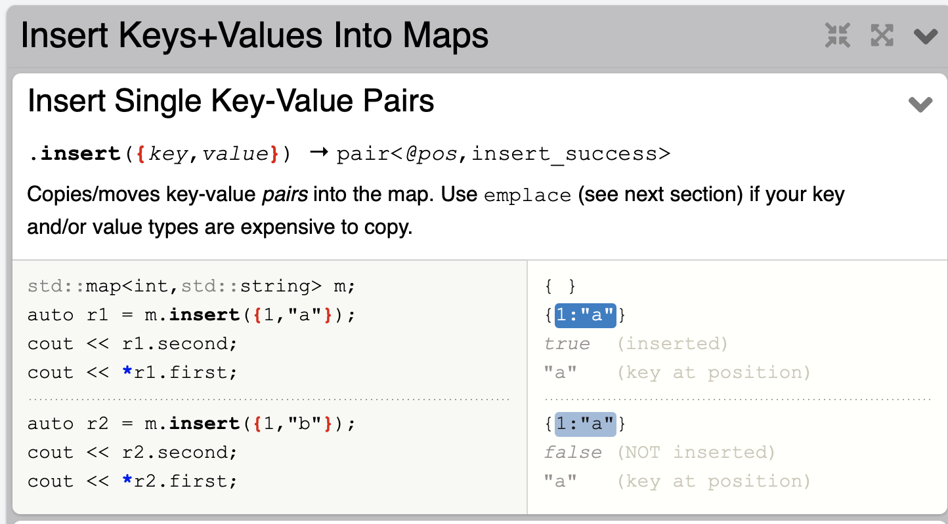
Insert elements: Map
https://hackingcpp.com/cpp/std/associative_containers.html#map

Slide 37
Map (an associative array)
For a vector, you subscript using an integer
For a map, you can define the subscript to be (just about) any type
int main()
{
map<string,int> words; // keep (word,frequency) pairs
for (string s; cin>>s; )
++words[s]; // note: words is subscripted by a string
// words[s] returns an int&
// the int values are initialized to 0
for (const auto& p : words)
cout << p.first << ": " << p.second << "\n";
}
Key type
Value type

Slide 38
Map
Some implementation defined type
// note the similarity to vector and list
template<class Key, class Value> class map {
// …
using value_type = pair<Key,Value>; // a map deals in (Key,Value) pairs
using iterator = ???; // probably a pointer to a tree node
using const_iterator = ???;
iterator begin(); // points to first element
iterator end(); // points to one beyond the last element
Value& operator[ ](const Key&); // get Value for Key; creates pair if
// necessary, using Value( )
iterator find(const Key& k); // is there an entry for k?
void erase(iterator p); // remove element pointed to by p
pair<iterator, bool> insert(const value_type&); // insert new (Key,Value) pair
// … // the bool is false if insert failed
};

Slide 39
Map example (build some maps)
map<string,double> dow; // Dow-Jones industrial index (symbol, price)
dow["MMM"] = 81.86;
dow["AA"] = 34.69;
dow["MO"] = 54.45;
// …
map<string,double> dow_weight; // dow (symbol, weight)
dow_weight.insert(make_pair("MMM", 5.8549)); // just to show that a Map // really does hold pairs
dow_weight.insert(make_pair("AA",2.4808));
dow_weight.insert(make_pair("MO",3.8940)); // and to show that notation matters
// …
map<string,string> dow_name; // dow (symbol, name)
dow_name["MMM"] = "3M Co.";
dow_name["AA"] = "Alcoa Inc.";
dow_name["MO"] = "Altria Group Inc.";
// …

Slide 40
Map example (some uses)
double alcoa_price = dow["AA"]; // read values from a map
double boeing_price = dow["BO"];
if (dow.find("INTC") != dow.end()) // look in a map for an entry
cout << "Intel is in the Dow\n";
// iterate through a map:
for (const auto& p : dow) {
const string& symbol = p.first; // the "ticker" symbol
cout << symbol << '\t' << p.second << '\t' << dow_name[symbol] << '\n';
}

Slide 41
Map example (calculate the DJ index)
double value_product(
const pair<string,double>& a,
const pair<string,double>& b) // extract values and multiply
{
return a.second * b.second;
}
double dj_index =
inner_product(dow.begin(), dow.end(), // all companies in index
dow_weight.begin(), // their weights
0.0, // initial value
plus<double>(), // add (as usual)
value_product // extract values and weights
); // and multiply; then sum

Slide 42
Containers have different benefits and costs
Advanced Programming

Slide 43
EXERCISE
Part I. Create five containers: a vector, a set, an unordered_set, a map and a multimap. Add the same 100 random entries to the containers (for the sequences containers add the random value r, for the map and multimap add the pair (r, fact(r)) ).
Part II. (After the next segment)

Slide 44
Advanced Programming
Measuring Time
Adriana Paluszny

Slide 45
Measuring time
Code needs to be profiled sometimes
Understand what really takes time
How much improvement does one strategy have over another

Slide 46
std::chrono
Provides a variety of clocks in the <chrono> header
Useful for when you want to program something that depends on time or for timing your code
Provides three clocks, all in the std::chrono namespace, with each providing a different guarantee

Slide 47
std::chrono::system_clock
std::chrono::system_clock is the system wide real-time clock
It is like your watch, or the clock on the wall
Gives elapsed time since an implementation specific start date
Most use January 1, 1970 at midnight (Unix Time)

Slide 48
std::chrono::steady_clock
std::chrono::steady_clock guarantees that its value will never decrease
Might seem absurd, but measuring time is complicated -- might have to deal with leap seconds and/or inaccurate clocks
So yes, this kind of stuff happens

Slide 49
std::chrono::high_resolution_clock
std::chrono::high_resolution_clock has the shortest tick period available tick is the smallest atomic change that the clock can measure (the granularity of the clock)
Beware of situations where tick is, say, millisecond, but clock is only updated every half second!
Mostly a historical issue now

Slide 50
now()
Each clock supports the static member function now(), which returns a time point corresponding to the current value of the clock
time point represents a moment in time
chrono encodes time points using std::chrono::time_point type

Slide 51
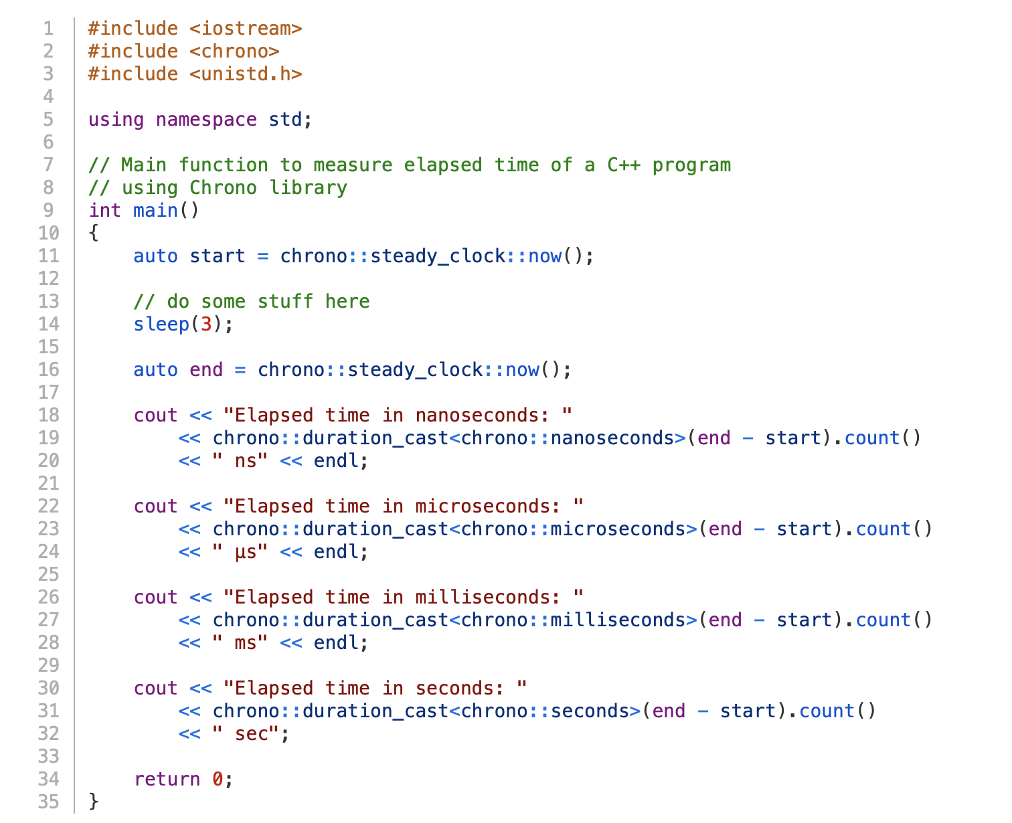
An example

Slide 52

Also consider…
Advanced Programming
Take the time to watch these amazing videos
https://learn.microsoft.com/en-us/shows/c9-lectures-stephan-t-lavavej-core-c-/
https://learn.microsoft.com/en-us/shows/c9-lectures-stephan-t-lavavej-standard-template-library-stl-/

Slide 53
EXERCISE
Part I. Create five containers: a vector, a set, an unordered_set, a map and a multimap. Add the same 100 random entries to the containers (for the sequences containers add the random value r, for the map and multimap add the tuple (r, fact(r)) ).
Part II. Extend your containers (without recreating them) so that they have a total of 10,000 entries each, with tuples (r,r) for the map and multimap. Do this by adding entries to your containers. Measure how long this takes. Then write another loop that erases all of the newly inserted items for each container type. Measure how long this takes.

